Slide 1

Visioning for Research, Outreach, and Inclusion
Matthew Weirick Johnson, MSLS
Santa Clara University
30 July 2021
academic.mattweirick.com
Notes:
Hello! Welcome! Thank you for having me. Before I get started, I just want to let everyone know that a copy of the slides and an accessibility copy of this presentation are available on my website academic.mattweirick.com. I’ll put a link in the chat to go directly to the presentation page on my website. That link will also be available again at the end of the presentation if there’s anything you want to come back to.

Slide 2
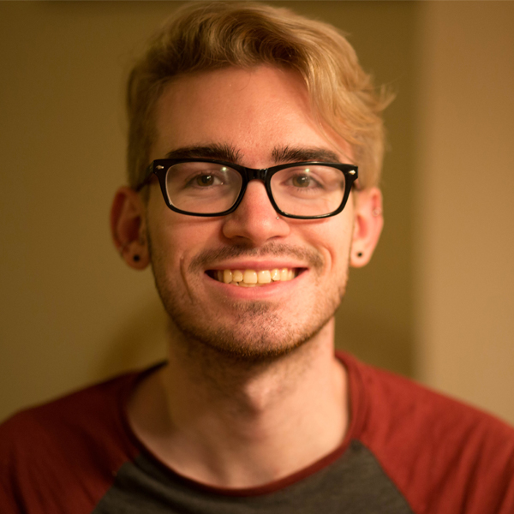
Introduction
Bachelor of English in Literature & Language; Virginia Tech, Blacksburg, VA
Master of Science in Library Science; University of North Carolina, Chapel Hill, NC
Graduate Certificates: SILS Diversity Advocate, Interdisciplinary Health Communication, Interdisciplinary Health Disparities
Community Workshop Series Coordinator
UCLA Library – Associate Librarian
Librarian for English, History, and Comparative Literature, Humanities & Social Sciences Lead for Research Services, and Lead for Teaching & Learning
Notes:
So, I’ll just take a quick minute to give some background about myself and who I am. Theoretically everyone has seen my CV and cover letter. I have a background in English, but while I was getting my MSLS, I got particularly interested in public health. I’ve worked as the Community Workshop Series coordinator at UNC, and I have a recent article about that experience that I’ll share at the end of the presentation. I’ve worked for a non-profit in NC advancing equity and social justice throughout the state, as a photographer for the North Carolina AIDS Action Network, and with a startup working to provide consumer health information. But we’re also all people outside of work. I like fantasy novels, and have a particularly tendency to choose not-so-great-ones, and I love both Gilmore and Gossip Girls, though I haven’t yet decided if I’ll watch the new TV version of Gossip Girls. I like board games, especially when they’re unnecessarily complicated and have multiple rulebooks. And, I’m currently living in the Old North State, North Carolina. The image on the right is a photo of me taken by my brother.

Slide 3

Agenda
Background Information & Considerations
Prompt
Goals
Values
A Process for Shared Visioning in Research, Outreach & Inclusion
A Vision to Develop & Apply a Social Justice Model
Involving Students in Shared Decision-Making
Supporting Library Staff and Providing Professional Development
Being Learner-Centered
Photo by Estée Janssens on Unsplash
Notes:
Here’s a quick agenda for the rest of the presentation, so everyone has a general sense of where we’re going and what I’m attempting to articulate. After this, we’re going to move into some background information and considerations where I’ll share the presentation prompt, the goals from Priority 1 of your strategic plan, and both your organizational values and some of mine. We move into a potential process for creating a shared vision in research, outreach, and inclusion. After which, I’ll move into a more focused discussion around some of my own vision and possible action for inclusion specifically around developing and applying a social justice model. The three central tenets for my vision here are involving students in shared decision-making, supporting library staff, and being learner-centered. I’ll talk about a couple of specific actions that we might pursue to achieve this vision. The image on the right is of a coffee cup on a planner taken by Esteé Janssens, available on Unsplash, which is a digital image repository with freely-usable images.

Slide 4

Background Information & Considerations
Notes:
So, I want to take a moment to provide some background information, considerations, context, and lots of hedging from me to inform everyone’s understanding of my approach to this presentation.

Slide 5
Prompt
The SCU Library’s strategic plan centers social justice, anti-racism, and diversity, equity, and inclusion as core areas of focus. Please describe your vision for how the SCU Library could advance this work based on the goals described in Priority 1 of the strategic plan.
Feel free to frame your presentation around specific goals and/or objectives that resonate with you or more broadly relate to the research, outreach and inclusion elements of this position.
Notes:
Here’s my obligatory inclusion of the presentation prompt, which I’ll just quickly read. “The SCU Library’s strategic plan centers social justice, anti-racism, and diversity, equity, and inclusion as core areas of focus. Please describe your vision for how the SCU Library could advance this work based on the goals described in Priority 1 of the strategic plan. Feel free to frame your presentation around specific goals and/or objectives that resonate with you or more broadly relate to the research, outreach and inclusion elements of this position.”

Slide 6
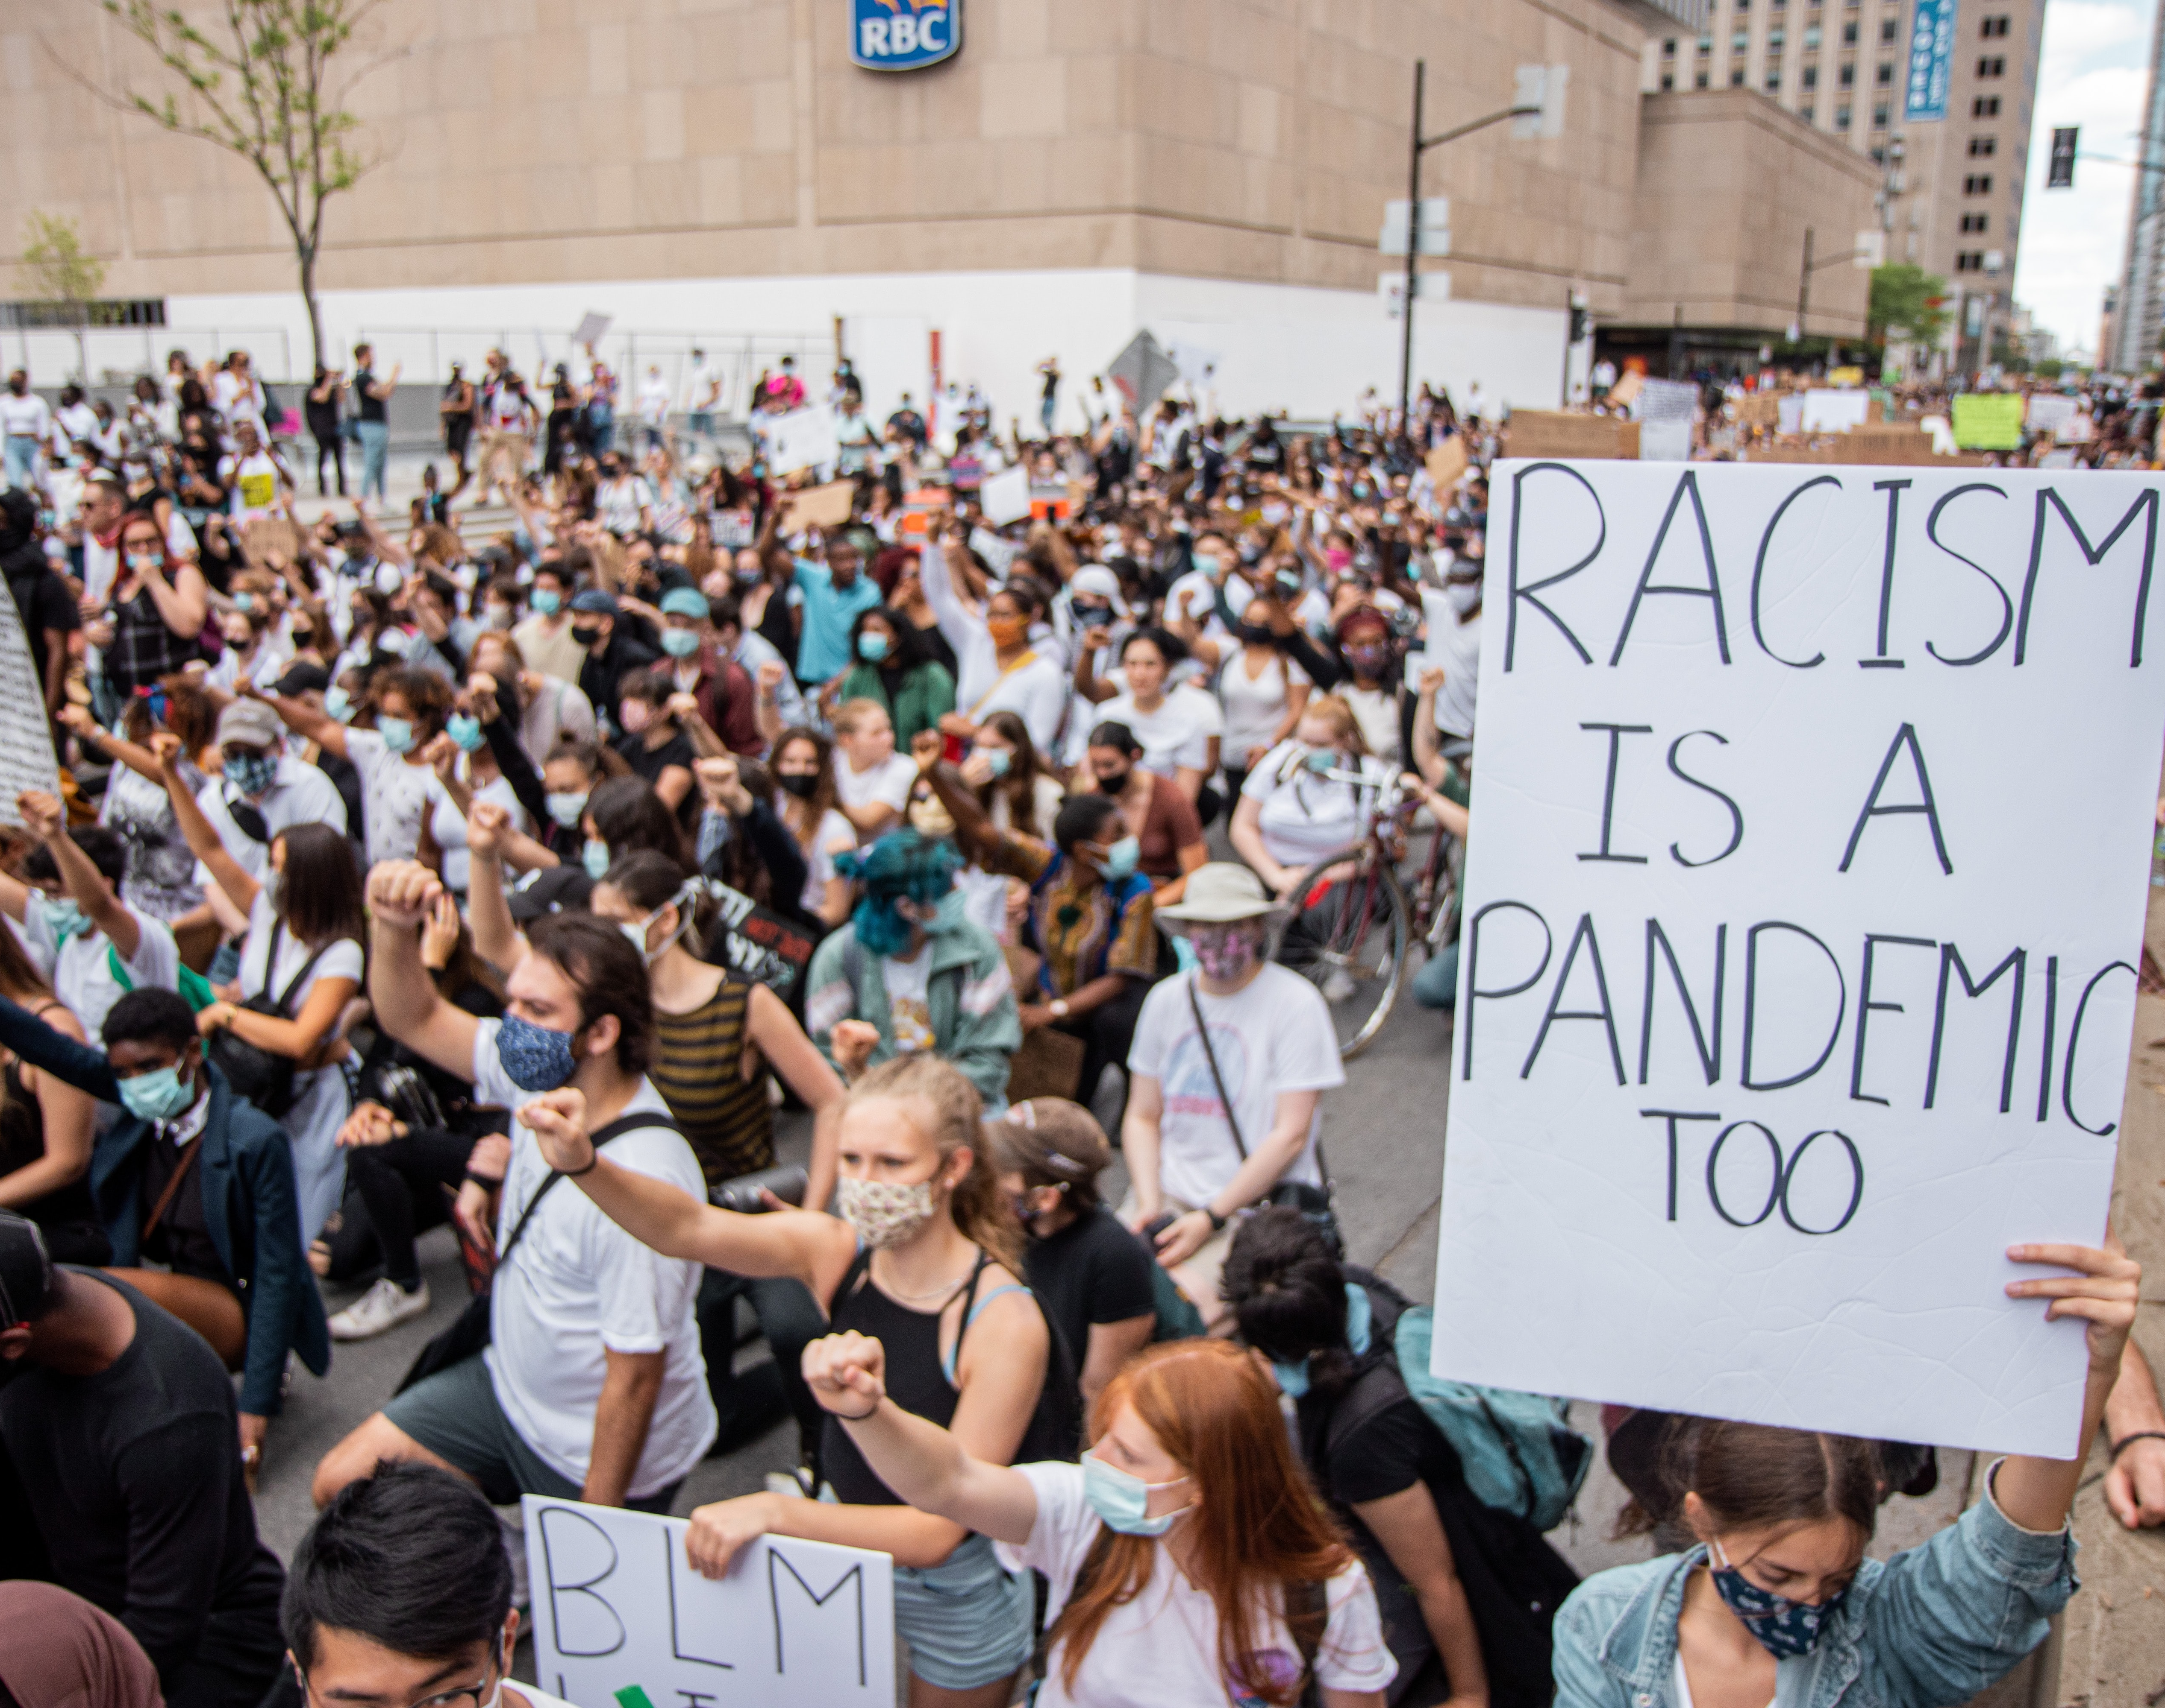
Priority 1: Develop and Apply a Social Justice Model
Goal 1: Initiate a process to reflect on what it means to be a social justice library.
Goal 2: Apply the principles of diversity, equity, inclusion, and social justice.
Goal 3: Create opportunities for sharing of and engagement with social justice initiatives.
Photo by Ying Ge on Unsplash
Notes:
From here, I just wanted to pull out Priority 1 of the strategic plan a bit more specifically in an attempt to center the presentation around this work, though I really appreciate the interconnectedness of all of the priorities in the strategic plan, and I hope I’ll be able to point to those connections throughout the presentation to present a holistic view of how anti-racist, social justice, and EDI work contributes across the strategic plan and across the organization, while also bridging back to the outreach and research functions of this position as well. Priority 1 is to “develop and apply a social justice model. Goal 1: Initiate a process to reflect on what it means to be a social justice library. Goal 2: Apply the principles of diversity, equity, inclusion, and social justice. Goal 3: Create opportunities for sharing of and engagement with social justice initiatives.” In this presentation, I present a few avenues for achieving these goals and some suggestions for how we can imagine pathways together to achieve these goals. The image on the right, taken by Ying Ge, depicts a Black Lives Matter protest, and we can see someone holding a sign that reads “racism is a pandemic too.”

Slide 7

University Library Values
Compassion and social justice
Engaged learning
Transparent and collaborative processes
Excellence in service
Staff development and professional growth
Academic and intellectual freedom
Civil discourse
Stewardship of library resources
Photo by Clark Tibbs on Unsplash
Compassion and social justice
Engaged learning
Transparent and collaborative processes
Excellence in service
Staff development and professional growth
Academic and intellectual freedom
Civil discourse
Stewardship of library resources
Photo by Clark Tibbs on Unsplash
Notes:
As we think about the strategic plan, these specific goals, and a shared vision, I want to reflect back on the Library’s stated values: compassion and social justice, engaged learning, transparent and collaborative processes, excellence in service, staff development and professional growth, academic and intellectual freedom, civil discourse, and stewardship of library resources. And I'd like to specifically call out compassion and social justice, transparent and collaborative processes, and staff development and professional growth as values that I think I speak to specifically in this presentation and that I’ll try to call us back to as we think about a shared vision. The image on the right shows a neon sign that reads “do something great,” and was taken by Clark Tibbs.

Slide 8

Some of My Values
Shared decision-making
Active listening
We can never communicate enough
Learning about a (work)place (no parachuting)
Ideas not concrete plans
Notes:
I’ve spent a bit of time recapitulating information about the Library that you probably already know, and I’m sure everyone is here to learn more about me. So, here are some of my values that I think are aligned with the Library’s values and that inform how I’m approaching this presentation prompt. I think shared decision-making is incredibly important and is aligned with the Library’s value of transparent and collaborative processes. Especially in anti-racist and social justice work, I think we all need to be involved and engaged in the process because we can’t be a social justice Library unless everyone is doing the work and committed to the goal. In achieving shared decision-making, I think that active listening is important and specifically listening to understand rather than listening to respond. I also think that in shared decision-making, we need to make space for everyone to be heard, to share evidence, and to be informed, but sometimes at the end, it’s not about everyone agreeing but at least everyone knowing and understanding the reasoning behind the final decision. Sometimes, I think active listening also requires time to reflect before a response is possible and creating that space is important. At the same time, one of my colleagues once said that we can never communicate enough, and it’s really stuck with me. It seems that there’s always something that slips through the cracks, or there’s a different medium of communication people would like used, or we just don’t know exactly what people want to know. Funnily enough, just last week, a colleague remarked that I’m an excellent communicator. Of course, when he said it, it was to give me more work communicating about a campus project. The last two points here are really just to hedge a bit about my presentation. For me, this is valuable, and all of this background information is valuable, because I hope it will help inform your understanding of whether or not my values align with yours and with where you want to go in order to help you decide who you want in this position. I think it’s really important to learn about a place and to understand the context of a workplace before making big decisions. I have some ideas here in my presentation, but if selected for the position, I would want to take the time to learn from all of you and listen to your ideas and your visions for your work before trying to impress my own. Similarly, I hope to present some ideas that may or may not work in the institutional context, but the ideas are certainly flexible and not concrete plans for the future. I hope that we can use shared decision-making to think, vision, and plan together. The image on the right is a photo of me writing and was taken by my brother.

Slide 9

Susan Leigh Star (1990)
”Every enrolment entails both a failure to enrol and a destruction of the world of the non-enrolled”
Photo by Lars Blankers on Unsplash
Notes:
To accompany my values, I have three quotes that I think inform some of my thought. In an article on infrastructure, power, and being allergic to onions, Susan Leigh Star says “every enrolment entails both a failure to enrol and a destruction of the work of the non-enrolled.” This quote has always stuck with me because I think it relates to the importance of shared decision-making. Whenever we make collective decisions, we cut off the possibility of worlds created out of the other possible decisions. I think this quote centers the consequences of decision-making. And certainly, there are low stakes decisions that we shouldn’t endlessly ring our hands over, but we have to be able to identify the stakes. The quote is also more interesting as we think about infrastructure and about the Library as a research, scholarly communication, and student support infrastructure for a university campus and when coupled with her claim that infrastructure is invisible until it breaks down. The image on the right taken by Lars Blankers is of many onions.

Slide 10

Freire – Pedagogy of the Oppressed
“Leaders who do not act dialogically, but insist on imposing their decisions, do not organize the people–they manipulate them. They do not liberate, nor are they liberated: they oppress.”
Photo by Volodymyr Hryshchenko on Unsplash
Notes:
In Pedagogy of the Oppressed, Freire writes “[l]eaders who do not act dialogically, but insist on imposing their decisions, do not organize the people—they manipulate them. They do not liberate, nor are they liberated: they oppress.” This centers, for me, the importance of dialogue and active listening as we approach shared decision-making. I also use this quote because I want to center pedagogy in the work that I do. I think that research and outreach are both pedagogically-informed, and pedagogy help us be intentional in our approach. Similarly, I think it’s impossible to only do anti-racist and social justice work in only one context, but instead, it has to be part of all of the aspects of our work and all aspects of our lives. The image on the right taken by Volodymyr Hryshchenko shows note cards organized into a speech bubble with an ellipsis in the middle.

Slide 11
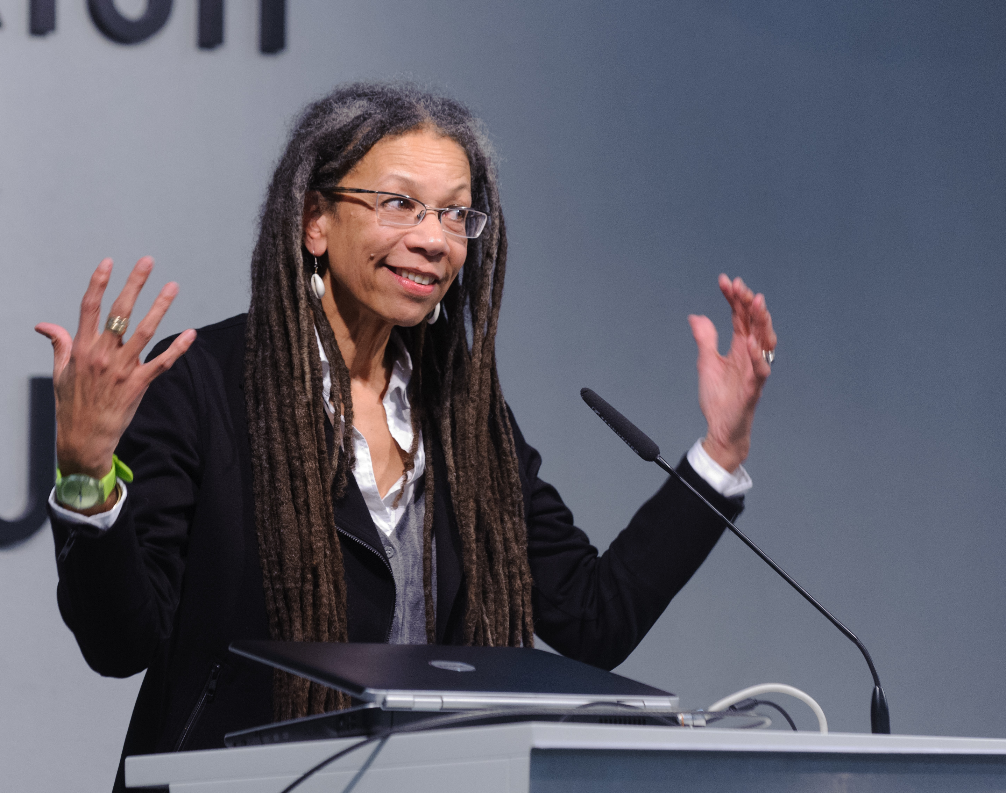
Ruth Wilson Gilmore
“Sit on committees that make decisions, not committees that make reports”
Photo by Stephan Röhl, CC BY-SA 2.0 via Wikimedia Commons
Notes:
Finally, Ruth Wilson Gilmore recently said “sit on committees that make decisions, not committees that make reports.” This really stuck with me because it’s a reminder of the importance of making decisions, a reminder not to be afraid to make decisions, and a reminder that decisions are active and they move us forward. For information professionals in particular, I think this is also a reminder that we can continue to collect data and organize information, but we have to be willing to do something with it, to take action, to make informed decisions. Freire also wrote “it’s in making decisions that we learn to decide,’ which I think reminds us that decision-making is its own skill that we develop throughout a lifetime, and shared decision-making is a skill that we have to develop together and that asks different contributions of us in each group. The image on the right by Stephan Röhl is of Ruth Wilson Gilmore presenting at a podium.

Slide 12

A Process for Shared Visioning in Research, Outreach & Inclusion
Relates to every priority in the strategic plan
Notes:
With all of this in mind, I want to shift into thinking about vision by imagining a possible process for shared visioning around research, outreach, and inclusion that I think relates to every priority of the strategic plan, because these three items—research, outreach, and inclusion—are pretty expansive. And the process is a little bit vague here, but I think it moves us into thinking about ways to engage and inform the work.

Slide 13
Overview
Listen
Learn
Reflect
Advocate
Communicate
Engage
Colleagues' goals, destinations, desires
Context
Documentation
Processes
Past
Identify what is shared
Consider what is needed
Align our work with the vision and goals
Make space for new work and priorities
Share the vision with stakeholders
Develop a plan for sustainable, open, and transparent communication
Engage colleagues, users, and community in enacting the shared vision
Notes:
Here’s a quick overview of the process that I’m imagining. I think it connects well both to my values and to the organization values in the service of achieving the vision that’s already set out in the strategic plan. There are sort of 6 steps that are presented here linearly for the sake of simplicity, but that I think form a more iterative and messy process than the diagram displays. But the six actions are listen, learn, reflect, advocate, communicate, and engage. In listening, I want to center colleagues’ existing goals, destinations, desires, and work to recognize both what work is already happening and what work people would like to see happening. In learning, I’d like to center learning about the past, what has worked and what hasn’t, the institutional context, what processes are already in place and how they work or don’t work, and to explore existing documentation. In reflecting, I want to make time to explore what I’ve heard and what I’ve learned and to think about what is needed and what is shared. In thinking about reflection, I’m also thinking about reflection as an assessment activity and about assessment as an act of care, which will come up a few more times in this presentation. I think assessment can be a temperature or well-being check, and act of care to make sure we’re succeeding together and moving together. As a not super relevant but fun and demonstrative example, if we took the entire Library staff down to LA and went to hike up to the Hollywood sign together, in order to keep our group moving together, we would probably have to check-in with people at the back to make sure they’re doing alright, see if they need breaks, and make sure they have what they need, and we would have to communicate that throughout the group, maybe ask the people in the front to slow down or take a break with us or help provide some of that support so we can move together. In this example, there are likely many visual cues that make it easy to know when to check-in, but we have to work to identify those moments and identify when support is needed and what support is needed. In advocating, I want to align our work with the vision and goals, and advocate for that vision to make space for new work and priorities, which might mean shifting where we focus our efforts in line with where we focus our priorities. In communicating, I want to share the vision with stakeholders and engage stakeholders in a dialogue about the vision. The work of communicating and engaging is directly related to organizational values as well as to Priority 5 of the strategic plan where I think it is important to leverage existing partnership and create new partnerships to achieve the shared vision.
Reflection as assessment; assessment as care
Communicate & Engage: Mention leveraging existing partnership and creating new partnerships – relate to Priority 5
Listen
Colleagues' goals, destinations, desires
Learn
Context
Documentation
Processes
Past
Reflect
Identify what is shared
Consider what is needed
Advocate
Align our work with the vision and goals
Make space for new work and priorities
Communicate
Share the vision with stakeholders
Develop a plan for sustainable, open, and transparent communication
Engage
Engage colleagues, users, and community in enacting the shared vision

Slide 14

A Vision to Develop & Apply a Social Justice Model
Notes:
So with a general idea of an inclusive process for developing and enacting a shared vision, I’d like to move into sharing some of my own vision both broadly and specifically.

Slide 15
Applying DEIA & Social Justice Principles
SCU Students, Staff & Faculty
SCU Library Employees
UL Leadership
SCU Leadership
Notes:
For me, it’s important that anti-racist and social justice principles be enacted at a grassroots level, and I think a servant leadership model is effective at achieving this. Here, we can see the upside-down pyramid, which is a common model for servant leadership. It reminds us of our responsibility to the campus community and centers the campus community above us vertically rather than having campus community below us. In thinking about this model, it’s important to support Library employees, and employees who feel supported and engaged will provide exceptional support and service to our campus community. I think it’s important here to clarify a difference between enacting social justice through servant leadership and enacting neoliberal values through a “have it your way” approach to our community. I think employees who are supported feel empowered to say no to our community when it’s necessary to do so. This can be incredibly difficult in a profession fraught with vocational awe and in a higher education culture that makes us doubt our own agency or worry about the impact on our performance assessments. I think this need to support Library staff is demonstrated in the tenets of my vision and is demonstrated in a way that doesn’t lose sight also of our goal to support faculty, staff, and students through inclusive excellence and excellence in service.
Social justice through servant leadership
SCU Students, Staff, & Faculty
SCU Library Employees
UL Leadership
SCU Leadership

Slide 16
Overview of Vision
Accountability and intentionality
Involve users in the work via shared decision-making and structures for open, multidirectional, and transparent communication
Support University Library staff via training and assessment as care
Center learners to align existing and future services and be accountable to our values
Notes:
Moving into specifics aspects of vision, I center the ideas of accountability and intentionality that are value-driven and user-centered. We involve users in the work via shared decision-making and structures for open, multidirectional, and transparent communication, support University Library staff via training and assessment as care, and center learners to align existing and future services and be accountable to our values. In the next slides, I’ll talk more about these ideas and specifics on how this vision might be achieved.

Slide 17
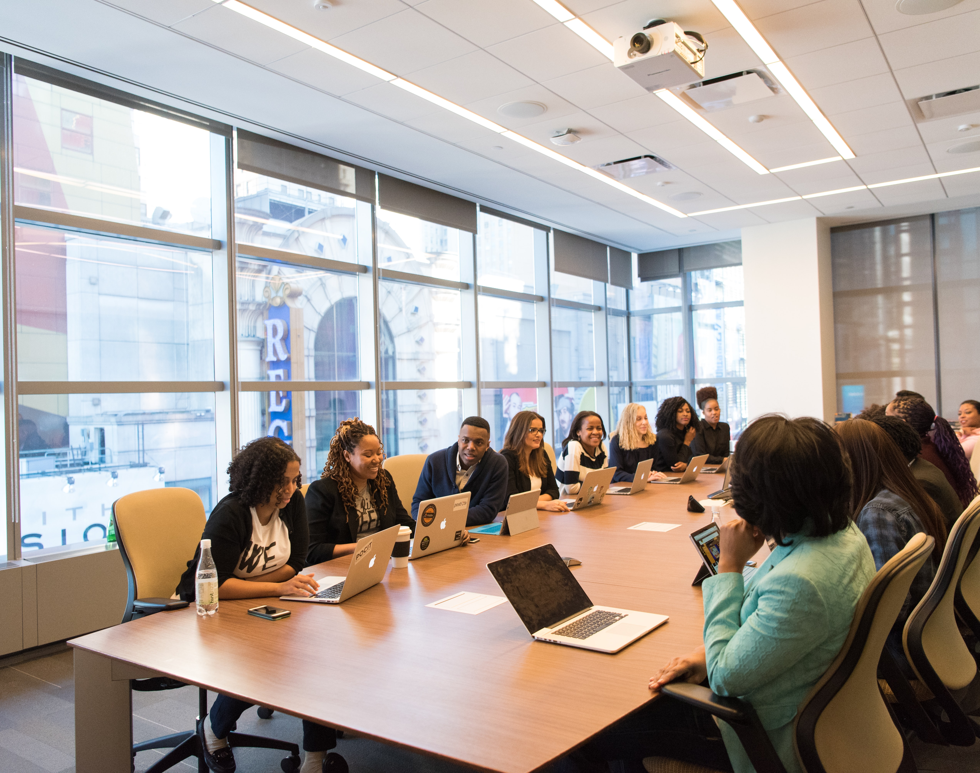
Involve Users
Advocacy/advisory board
Avenues for communication
Student workers as employees and users
Photo by Christina @ wocintechchat.com on Unsplash
Notes:
I think that finding new or additional ways to involve users is particularly important. The Library already has great mechanisms for assessment, but additional opportunities for direct communication provide opportunities for accountability and a feeling that their voice is heard. Similarly, student workers can be an excellent bridge for learning about both the student and staff member experience. By empowering student workers, we can put a finger on the pulse of the university. Similarly, involving users like students and faculty helps us turn those users into advocates and activates our base to bring more people into our services and do some of the outreach for us. The image on the right by Christina @ wocintechchat.com shows a group of people gathered at a large meeting table
Turns users into advocates, activate our base

Slide 18
University Library Advisory/Advocacy Board
Made up of students or students, faculty, and staff
Often faculty already have input through Faculty Senate or other university governance structures
Allows direct engagement & input with user community and creates a continued system for this communication – input on services, policies, spaces, programming, etc.
Provides an opportunity for active listening and shared decision-making
Promote EDI by centering people from historically oppressed groups
Budget & Recruitment
Notes:
I’m particularly invigorated by the idea of a student advocacy or advisory board. There are really a lot of options or decisions to help make this work in any institutional context. The board can have whatever level of authority or impact people want. Depending on existing governance models, the board might be only students or include faculty and staff as well to give them a greater voice. But, the board provides the opportunity to get input on services, policies, spaces, programming, technology, and other aspects of the Library, gives us more qualitative opportunities to learn what students want and what they’re thinking, and provides a structure for both communication and accountability. As we consider the budget and recruitment, I think there are ways to also center EDI and anti-racist praxis in the formation and advocacy of the group, especially by financially compensating members and centering members from oppressed or marginalized groups.
Relate back to organizational values
Related to Priority 5: Build and Sustain Distinctive Collaborations and Partnerships

Slide 19

Support Library Staff
Build training opportunities
Assessment as care (Veronica Arellano Douglas)
Photo by Rabie Madaci on Unsplash
Notes:
In addition to involving users in the vision and making sure that the future is user-centered, I think it’s important not to lose sight of staff and to ensure that staff feel supported and empowered to do good work and to do work that’s aligned with the vision. Especially with social justice and anti-racist work, I think it’s impossible to truly do the work unless everyone is committed to doing it together and feels supported in doing the work and holding the Library accountable when necessary. We have to support library staff and again center assessment as a form of care or a way of checking in. Surveys, regular check-ins with managers, or stay interviews are all ways of doing this as long as they are centered on staff and on care rather than on a performance of listening. I this sense, I think the Library climate survey and landscape analysis mentioned in Priority 3, Goal 2 could be really helpful to inform this aspect and to help align work in this area with what is needed. The image on the right by Rabie Madaci shows someone using a stack of books to reach a higher shelf.
Also aligns with Priority 3: Strengthen the Library’s Long-term Organizational Health and Success

Slide 20
Support Staff & Create Opportunities for Professional Development & Growth
Retention begins at recruitment
Recruitment begins with students
Assessment as care: library climate survey and landscape analysis (Priority 3, Goal 2)
What is the goal of EDI-related PD for Library staff?
Notes:
Skipped slide.
Also aligns with Priority 3: Strengthen the Library’s Long-term Organizational Health and Success

Slide 21

Center Learners
Our learners: students, faculty, Library staff
Assessment as care (Veronica Arellano Douglas)
Photo by javier trueba on Unsplash
Notes:
Finally, I think it’s important to center learners, which I think is distinct from involving our users. Here, I think learners can be just about anyone, but I specifically identify students, library staff, and faculty as possible learners. And I mention assessment as care here again to think about ways that assessment of learning can be an act of care rather than metrics to convey value. The image on the right by javier trueba shows a person hugging a book and standing in front of a group of people sitting at desks.

Slide 22
Learner-Centered Design & Universal Design
Being value-driven — what are our shared values?
Incorporating EDIA, Social Justice, Learner-Centered, and Universal Design principles into rese arch & outreach resources
Research Guides
Research Help
Peer-to-peer services — What can we learn from our learners?
Centering learners from historically marginalized and oppressed groups
Notes:
In centering learners, I’m thinking about learner-centered and value-driven design across services and programs. This requires recognizing our shared values and recognizing how we can enact those values. It might also mean recognizing universal design in the implementation of services, programs, and spaces. For research & outreach services in particular, I think it’s helpful to center peer-to-peer services and again to rely on student workers to help us center our learners in the design of things from research guides and research help to events, tours, and other outreach.
Value-driven

Slide 23

Wrapping Up
Notes:
I really just want to wrap up quickly with some of my own DEIA work to show past precedent for future work.

Slide 24
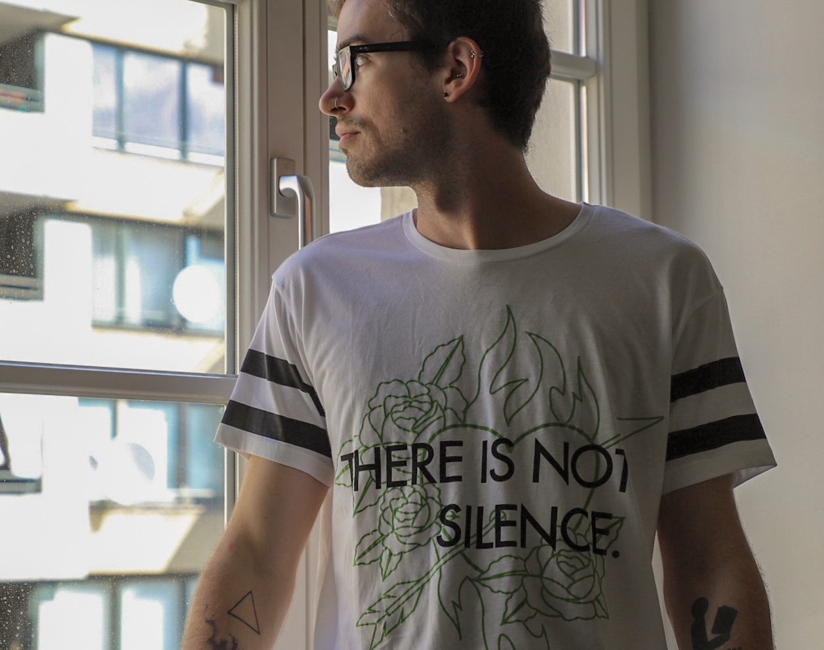
Some of my DEIA Work
Anti-Racist Pedagogy Workshop Series
Honors 101i: Research Today: Sources, Tools, and Strategies
The Mellon Mays Undergraduate Fellowship Writing and Research Training Program at UCLA
User Engagement Accessibility Committee
UCLA Library Diversity, Equity & Inclusion Committee
UCLA Library Unified Access Services & User Engagement Anti-Racism Cross-Functional Team
UCLA Sexual Health Coalition
ACRL Instruction Section Diversity and Inclusion Task Force
North Carolina AIDS Action Network
Planned: Research Practice 110A: Careers in Libraries & Archives
Notes:
I helped create an anti-racist pedagogy workshop series at UCLA Library that you can learn more about in a 5-minute presentation I did for the Librarians Association of the University of California. I’ve co-taught a credit-bearing course, Honors 101i, and a summer program for Mellon Mays Undergraduate Fellows, which is a program with the express purpose of diversifying the professoriate. I’ve been part of several committees and teams across campus and in professional and community organizations. And, I have a proposed course that will theoretically be offered next year about Careers in Libraries & Archives that has a stated goal of exposing more people from oppressed groups to the professions. The photo on the right is a self-portrait of myself.

Slide 25
Bibliography
Agyen, A., Araújo, J., Johnson, M. W., Lee, S., Newby, A., Romero, R. & Westrup, L. (under review). “Writing and Research Training Program: A UCLA Campus Partnership to Support BIPOC, LGBTQIA, and Disabled Student Researchers.” In Hensley, M.K., Fargo, H.M. & Davis-Kahl, S. (Eds.), Undergraduate Research and the Academic Librarian: Case Studies & Best Practices, Volume 2.
Arellano Douglas, V. (2020). Moving from critical assessment to assessment as care. Communications in Information Literacy, 14(1), 4.
Freire, P. (2018). Pedagogy of the oppressed. Bloomsbury publishing USA.
Harper, T., Mody, N., Ravaei, K., Romero, R., & Worsham, D. (2020). The WI+ RE Way. Journal of New Librarianship, 5(1), 1-24.
Johnson, M. W., Abumeeiz, S., & McAulay, E. (2021). Teaching in the digital library: A partnership between teaching librarians and digital library staff. College & Research Libraries News, 82(7), 302.
Johnson, M. W., & Lasher, M. (2020). The Community Workshop Series: A Case Study for Community-Engaged Learning in LIS. Library Trends, 69(4), 752-767.
Star, S. L. (1990). Power, technology and the phenomenology of conventions: on being allergic to onions. The Sociological Review, 38(1_suppl), 26-56.
Notes:
This is my bibliography, which you can see if you download the slides.

Slide 26
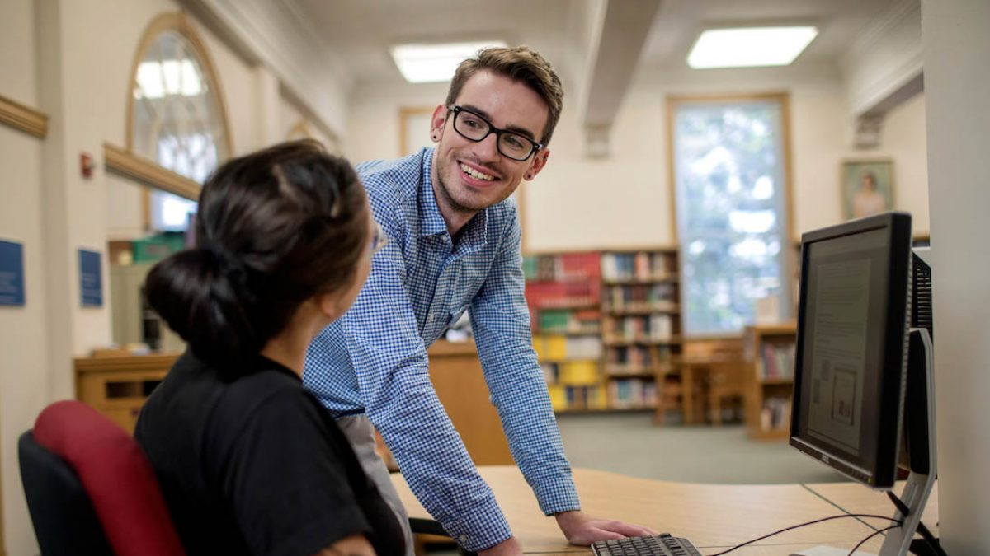




Contact Me
Matthew Weirick Johnson
academic.mattweirick.com
matt@mattweirick.com
academic.mattweirick.com/files/scu-presentation-20210730.pptx
academic.mattweirick.com/talks/2021-07-30-scu-presentation
Notes:
And, thanks for coming. You can find the presentation and accessibility copy for the presentation on my website. I think we have time for questions or comments from anyone. I’ve done a lot of talking, so I’m happy to hear from others. The photo above is a photo of me helping a colleague taken by UNC’s development office.

